Slide 1

FUNDAMENTAL ANALYSIS
FINM 693
CREDIT 3
Basit Ali Bhat
Teaching Assistant

Slide 2
FUNDAMENTAL ANALYSES
QUALITATIVE ANALYSES
Management
Corporate Governance
Research & Development
Labour Relations
Company Culture
Competitive Advantage
Industry type
QUANTITATIVE ANALYSES
Balance Sheet
Profit And Loss
Cash Flow

Slide 3
Pillars Of Fundamental Analyses
Economy Analyses
GDP
Inflation
Interest rates
Forex reserves (Balance of Payment)
Monsoon
Political stability

Slide 4
INDUSTRY/SECTOR ANALYSES
Overall knowledge about the sector or industry investors want to invest in
Identify the area where strategic changes will help to maximize profitability
Assess the future prospects of the company through industry or sector analyses
Forecast the actions taken up by potential competitors
One sector can have various industries

Slide 5
INDUSTRY
An industry is a group of companies that are related based on their primary business activities
An industry is a group of manufacturers or businesses that produce a particular kind of goods or services.

Slide 6
Industry Rivalry and Competition
Price Competition
Product Introductions
Slow Industry Growth
High strategic stake
High exit barriers
Economic, strategic, and emotional factors can prevent companies from leaving the industry, even when they are earning low or negative returns on investments. Major sources of exit barriers include:
Specialized assets
Fixed costs of exit
Strategic interrelationships
Emotional barriers
Government and social restrictions

Slide 7
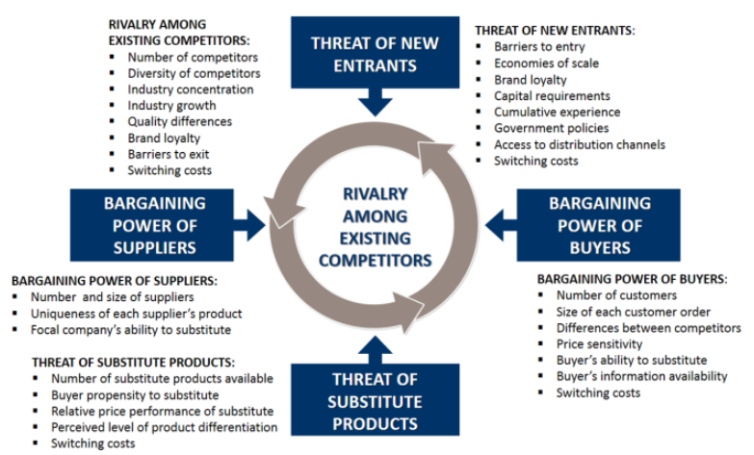
Porter’s Five Forces Model

Slide 8
HOW INDUSTRIES CHANGE
There are two types of threats to industries
The first is a threat to the industry’s core activities—the activities that have historically generated profits for the industry
These are threatened when they become less relevant to suppliers and customers because of some new, outside alternatives like car dealerships.
The second is a threat to the industry’s core assets—the resources, knowledge, and brand capital that have historically made the organization unique. PATENT EXPIRATION

Slide 9
TRAJECTORIES OF INDUSTRY CHANGE
Radical change (Government regulations and change of taste, travel industry, cellular telephones)
Intermediate change (music industry, auto dealership)
Creative change (relations with customers and suppliers are stable) Film Industry
Progressive change (Feedback, airline industry)
Identify Trajectory
Define your industry
Define industry core assets and activities
Determine whether core assets and activities are threatening with obsolescence
Evaluate where the industry is in the cycle

Slide 10
Business Cycle
A business cycle refers to the periodic expansion and contraction of a nation’s economy.
The business cycle refers to fluctuations in the economy between periods of expansion (growth) and contraction (recession).
The recurring and fluctuating levels of economic activities that an economy experiences for a long period of time.
A cycle consists of expansion, recession, contraction, and revival

Slide 11
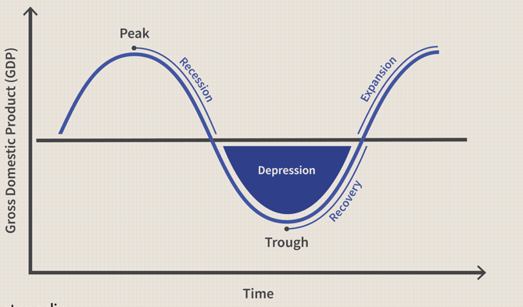
Business Cycle

Slide 12
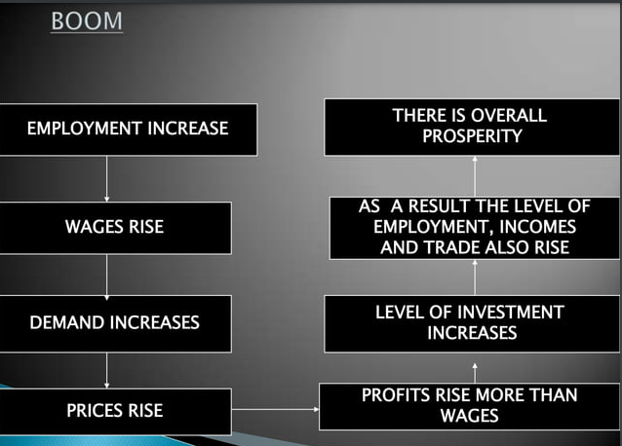

Slide 13
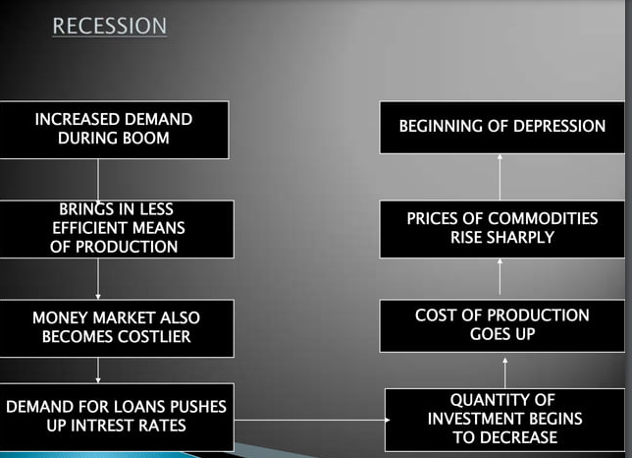

Slide 14
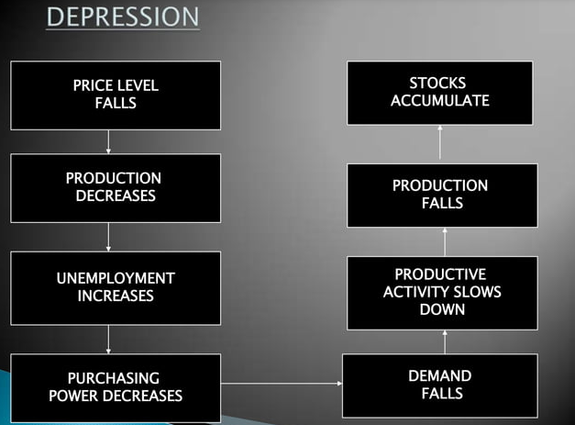

Slide 15
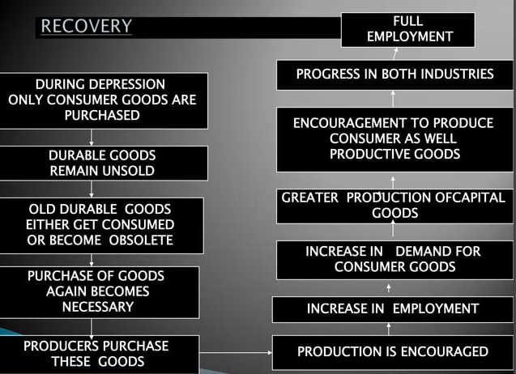

Slide 16
Investing During Business Cycle
During the recession phase, the lowest point in the business cycle, economic activity is at its weakest, and unemployment is at its highest. Many industries may struggle during this phase, especially those dependent on consumer spending or business investment.
However, certain industries are able to weather the storm during a recession because they offer products and services that people need no matter how the economy is performing. These industries include healthcare, consumer staples, and utilities.
Early Cycle (Start of Expansion)
Mid-Cycle (Full Capacity)
Late Cycle

Slide 17
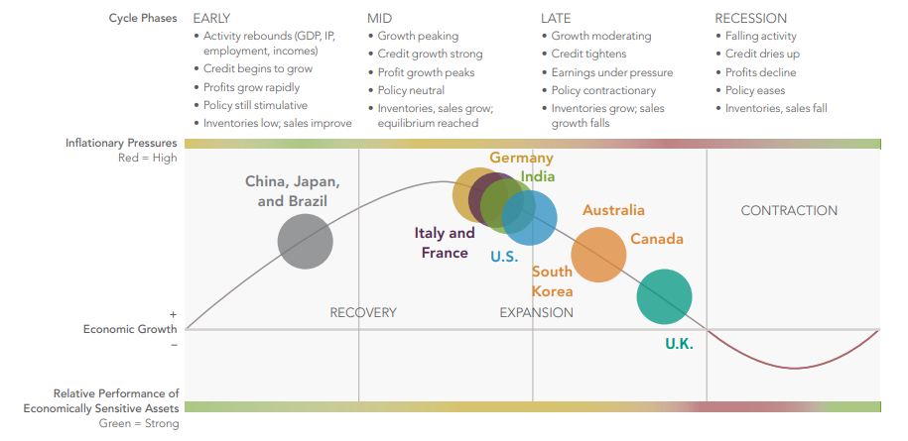

Slide 18
Consumer Goods: Automotive, Housing, And Retail And Finance
It And Basic Material
Energy, Utilities, Healthcare, And Consumer Staples.

Slide 19
INDUSTRY LIFE CYCLE
WHY INDUSTRY LIFE CYCLE
Industries go through different stages in their lifetime which affects their existence or survival
It makes investors understand where is particular industry standing at A particular time and situation
It guides investors to make strategies according to the cycle industry goes through

Slide 20
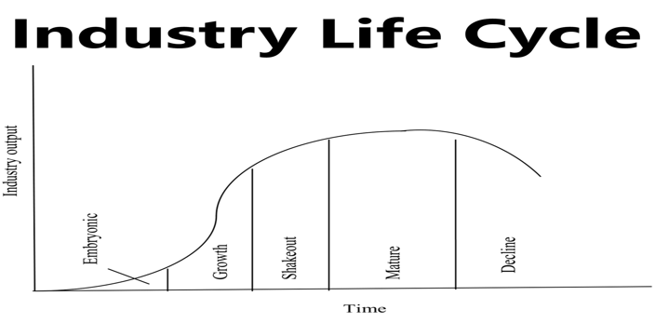
INDUSTRY LIFE CYCLE

Slide 21
INDUSTRY LIFE CYCLE
EMBRYONIC STAGE
GROWTH STAGE
SHAKEOUT
MATURE
DECLINE

Slide 22
INDUSTRY LIFE CYCLE
2. EMBRYONIC STAGE
An industry just beginning to develop, characterized by slow growth, high prices, low volumes, a substantial need for investment, and a high risk of failure.
Challenge is to educate customers, open up distribution channels, and design the perfect product

Slide 23
INDUSTRY LIFE CYCLE
1. GROWTH STAGE
Characterized by rapidly increasing demand, improving profitability, falling prices, and relatively low competition
Prices fall
Everyone has a scope to grow
Demand Grows
Market research

Slide 24
INDUSTRY LIFE CYCLE
3. SHAKEOUT STAGE
Characterized by slowing growth, intense competition, declining profitability, and a focus on cost reduction
Demands saturate
First-time buyers decline
Rivalry high
Chances of loss

Slide 25
INDUSTRY LIFE CYCLE
4. MATURITY STAGE
At this Stage the majority of companies are well established and the industry reaches its saturation point
Characterized by little or no growth, industry consolidation, and high barriers to entry.
Companies collectively attempt to deter new competitors in the industry
Maximum revenue
Profits
High demand
Product Popularity
Reasonable prices

Slide 26
INDUSTRY LIFE CYCLE
4. DECLINE STAGE
Characterized by negative growth, excess capacity, and intense competition.
Technology Changes
Social Changes
Demographic Change
International Competition
Decline of competition based on several reasons
Larger companies acquire small players
Disinvestment in case of huge losses

Slide 27
INDUSTRY LIFE CYCLE
QUESTIONS
PRINT MEDIA?
SOLAR INDUSTRY?
MICROPROCESSORS?
AUTOMOBILE INDUSTRY?

Slide 28
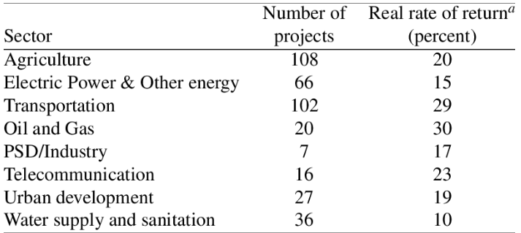
INDUSTRY RATE OF RETURN

Slide 29
INDUSTRY RATE OF RETURN
COMPANY | RETURNS | INDUSTRY RETURNS
HERO | 10% | 12%
BAJAJ | 9%
HONDA | 7%
YAMHAHA | 6.5%
SUZUKI | 7.23%
TVS | 4%

Slide 30
RELATIVE VALUATION
A type of business valuation method that analyzes the value of a company to the value of its competitors or industry peers in order to determine the financial worth of such a company
It makes use of multiples, averages, ratios, and benchmarks to determine a company's worth.
It is also used by investors to make informed decisions before buying a company's stock

Slide 31
RELATIVE VALUATION
P/E RATIO
P/B RATIO
PRICE TO FREE CASH FLOW
ENTERPRSIE VALUE/EBITDA

Slide 32
P/E RATIO
Price to Earnings Ratio or Price to Earnings Multiple is the ratio of the share price of a stock to its earnings per share (EPS). PE ratio is one of the most popular valuation metrics of stocks. It provides an indication whether a stock at its current market price is expensive or cheap
P/E = Market price per share/earning per share

Slide 33
P/B RATIO
The price-to-book (P/B) ratio measures the market's valuation of a company relative to its book value. The market value of equity is typically higher than the book value of a company's stock
P/B Ratio = Market Value Per Share/Book Value Per Share

Slide 34
PRICE TO FREE CASH FLOW
Price to free cash flow removes capital expenditures, working capital, and dividends so that you compare the cash a company has left over after obligations to its stock price
P/CF Ratio = Market Capitalisation/Cash From Operations

Slide 35
ENTERPRSIE VALUE/EBITDA
Enterprise Valuation ratios are used to determine the current value of the firm. And these ratios also help in determining whether the firm is undervalued or overvalued. EV to EBITDA is a popular valuation metric known as Enterprise multiple or EBITDA multiple. Therefore, through this metric, enterprise calculation determines whether the firm is undervalued or overvalued. EV/EBITDA calculation happens by dividing Enterprise Value (EV) by Earnings before Interest Tax Depreciation & Amortization (EBITDA).
ENTERPRISE VALUE = assets+ investments+ profits +debts
EBITDA = PROFITS + INTEREST + TAX+ DEP + AMORTISATION

Slide 36
ANALYSES OF FINANCIAL STATEMENTS(BALANCE SHEET)
DEBT TO QUITY RATIO = DEBT/EQUITY
DEBT BURDEN RATIO = DEBT/FCF
CREDITOR DAYS = TRADE PAYABLES/SALES X 365
LIVE EXAMPLES FROM BALANCESHEET FROM MONEY CONTROL

Slide 37
ANALYSES OF FINANCIAL STATEMENTS(BALANCE SHEET)
DEBTOR DAYS = TRADE RECIEVABLES/SALES X 365
CURRENT RATIO = CURRENT ASSETS/ CURRENT LIABILITY
LIQUID RATIO/ QUICK RATIO/ACID TEST RATIO = QUICK ASSET/ QUICK LIABILITIES
QUICK ASSET= CURRENT ASSET- STOCK AND PREPAID ASSETS
QUICK LIABILITIES = CURRENT LIABILITIES – BANK OVERDRAFT
LIVE EXAMPLES FROM BALANCESHEET FROM MONEY CONTROL

Slide 38
ANALYSES OF PROFIT AND LOSS ACCOUNT
REVENUE
COSTS
GROSS PROFIT
EXPENSES
EBITDA
DEPRECIATION
AMORTIZATION
EBIT
INTEREST
TAX
NET PROFIT
LIVE EXAMPLES FROM PROFIT AN LOSS FROM MONEY CONTROL

Slide 39
CASH FLOW STATEMENT
CASH FLOW FROM OPERATIONS
Cash inflows: generation of cash from normal operations
Cash outflow: expenditure of funds in normal operations
CASH FLOW FROM INVESTING ACTIVITIES
Cash inflows: sale of plant and equipment and liquidation of long term investments
Cash outflow: purchase of plant and equipment and investment in long term investing activities
CASH FLOW FROM FINANCING
Cash inflows: debt issuance, common stock preference stock
Cash outflow: retirement of debts, payment of cash dividends
LIVE EXAMPLES FROM CASHFLOW STATEMENT FROM MONEY CONTROL

Slide 40
DISCUSSION ON VARIOUS RATIOS
BALANCSHEET RATIOS
EPS RATIO = company's profit divided by the outstanding shares of its common stock.
P/E RATIO = the market price of a share by the earnings per share.
CASH EARNING PER SHARE = Operating cash flow/ shares outstanding
DIVIDEND PER SHARE = Annual dividend paid divided by the number of shares outstanding
DIVIDEND PAY-OUT = Dividends Divided by net income
NET FIXED ASSET UTILISATION = Sales/net fixed assets

Slide 41
PROFIT AND LOSS RATIOS RATIOS
ROA RATIO = Net Income After Tax/Average Total Assets
ROE RATIO = Net Income After Tax-dividends On Preference Shares/Shareholders Equity
PRE-INTEREST RETURN ON ASSETS = Earning Before Interest And Tax/Average Total Assets
RETURN ON TOTAL INVESTED CAPITAL = Earning Before Interest And Tax /Average Total Invested Capital
INTEREST COVER RATIO = Earning After Interest And Tax /Interest Expenses

Slide 42
CASHFLOW RATIOS
DEFENSIVE RATIO = Average daily cash operating expenses/liquid assets
CURRENT LIABILITY RATIO = Cash inflow from operations/ current liabilities
DEBT COVERAGE RATIO = Internal generated funds /total debt
LIABILITY COVERAGE RATIO = Internal generated funds /total liabilities

Slide 43
THREE STEP VALUATION PROCESS
ECONOMIC VALUATION
INDUSTRY VALUATION
COMPANY VALUATION

Slide 44
VALUATION THEORIES
VALUE OF THE ASSET IS THE PRESENT VALUE OF FUTURE RETURNS
STREAM OF EXPECTED RETURNS
DIFFERENT FORMS OF RETURNS
TIME PAPPERN AND GROWTH RATE
You cannot calculate the accurate value of the security unless you can estimate when will you receive returns and cash flow
REQUIRED RATE OF RETURNS

Slide 45
STOCK VLAUATION
Balance Sheet Technique
Discounted MODEL
Relative Valuation
Book Value
Liquidation value
Replacement cost
Dividend discount
Discounted cash flow
P/E RATIO
P/B RATIO
P/S RATIO

Slide 46
Balance Sheet Technique
BOOK VALUE
Book value per share is simply the net worth of the company divided by the number of outstanding shares
EXAMPLE 1
Company A Has Net worth Of 1 Crore And Number Of Equity Shares Are 10 Lakh The Book Value Of Share Would Be
EXAMPLE 2
Infosys limited has a share capital of 500000
Reserves And Surplus are 600000
Mar cap is 1000000
Market Share price is 50

Slide 47
Balance Sheet Technique
Liquidation Value
EXAMPLE:
Assume that Jindal industries would realise rs 40 cr from the liquidation of its assets. Company paid full settlement of their claims towards creditors and preference shareholders f rs 10 cr and 8 cr respectively . the number of outstanding equity shareholders of Jindal industry is 1.5 lakhs. Calculate liquidation per share
LVPS = LIQUIDATION VALUE OF ASSET – SETTLEMENT TO CREDITORS - PREFRENCE SHARE HOLDERS /NUMBER OF OUTSTANDING SHARES

Slide 48

Balance Sheet Technique
REPLACEMENT COST
EXAMPLE
Assume that a company has 35 Lakh of assets. It also has 5 lakh shares outstanding that are trading for 4 a share. In this example, the Tobin's Q ratio would be

Slide 49
PRICE TO EARNING
The net income of the company A is 2 lakhs with the with the outstanding shares of 2.5 lakh. During the year company paid 20000 Rs of dividend towards preference stock holders. The current market price of the company is 150 RS. Calculate the PE ratio of the company.

Slide 50
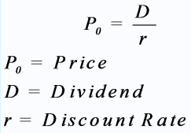
DIVIDEND DISCOUNT MODEL
Single Period dividend model with zero growth
MR TT expects that company will pay dividend of 10 RS next year . The current market price of share is 122 RS with the expected rate of return of 8%. Calculate intrinsic value of the stock?

Slide 51

DIVIDEND DISCOUNT MODEL
Single Period dividend model zero growth
Po = current price of equity share
D1 = dividend expected after one year
P1 = price of the share expected
R = Rate of return on equity share
EXAMPLE
HDFC is expected to provide dividend of Rs 4.00. Expected price of the share is 24 Rs. What price it would sell now if investors expected rate of return is 12%

Slide 52

With constant Growth
Expected dividend price per share is 4
The dividend growth is 5%
The equity share price will grow 5%
Calculate the intrinsic value of share if expected rate is 15%

Slide 53
Multi Period Dividend Model
Mr. D has forecasted that Punjab transport Corp will pay dividends of 4 in the first year, 5 in the second year, and 6 in the third year. You expect that at the end of the third year, the selling price of the company’s stock will be 125 per share. The estimated cost of capital is 5%. The current stock price is 100 per share.

Slide 54
DISCOUNTED CASH FLOW MODEL
The following are the projected cash flows to equity and to the firm over the next five years:
Total equity of the company is 66 crores with 6 crore of outstanding shares. The total debt of the company is 66 crores
(The terminal value is the value of the equity or firm at the end of year 5.)
The firm has a cost of equity of 12% and a cost of capital of 9.94%. Total tax paid by the company is 30%
What is the value of the equity in this firm?
What is value of the firm?
Year | Cash Flow To Firm | Net investment
1 | 240 | 90
2 | 257 | 94.50
3 | 274 | 99.23
4 | 293 | 104.19
5 | 313 | 109.40

Slide 55

BONDS
Bonds are fixed-income instruments
Represent a loan made by an investor to a borrower who in most cases will either be a country’s government or a corporate entity.
Bonds are utilized by governments and corporate entities to raise capital to finance operations or major projects.
The owners of the bonds are classed as creditors of the issuer.
Term Indenture

Slide 56
FEATURES OF BOND
Yield/Yield to Maturity (YTM) – The annual rate of return of a bond that is held to maturity (assuming all payments are not delayed).
Principal (or Face Value) – The initial amount of money invested in the bond
Maturity – The date that the bond expires, when the principal must be paid to the bondholder.
Coupon Rate – The interest payments that the issuer makes to the bondholder. They are typically made semi-annually (every six months) but can vary

Slide 57
FEATURES OF BOND
Issuer: Bond issuers borrow money from investors against bonds. Commonly found bond issuers are the government, government institutions, municipalities, and corporations.
Credit rating: Each bond holds the rating, provided by credit rating agencies. A higher rating suggests a lower amount of risk and lower yields. If the rating is lower, the risk involved in the bond is higher along with higher returns.
Tradable Bonds: Bonds are tradable in the secondary market. The ownership can thus shift among various investors within a given tenure. These creditors often sell their bonds to other entities when market prices exceed the nominal values as they have an option to secure bonds with high yield and appropriate credit ratings

Slide 58
Par Value
Premium value
Discount value

Slide 59
TYPES OF BONDS
Fixed-rate bonds
Fixed-rate bonds pay consistent interest amounts until maturity. The bondholders earn predictable and guaranteed returns regardless of the prevailing market conditions.
For example, An investor purchased a ten-year fixed-rate government bond of Rs. 1000, issued on 20th April 2022 which offers a coupon rate of 7.5%. The investor will get a fixed interest of Rs. 75, annually every April, till 20th April 2031.

Slide 60
TYPES OF BONDS
Floating-rate bonds
Floating-rate bonds do not pay fixed returns each period. Instead, the interest rates vary, depending on the set benchmark, during the tenure.
For example, an investor purchased an 8-year floating rate bond issued in 2015. The bond pays interest of 1% higher than the prevailing National Savings Certificate interest rate. This means the NSC interest rate is the benchmark and any fluctuation in it directly affects the coupon payment of this bond.

Slide 61
TYPES OF BONDS
Zero-coupon bonds
As the name implies, these bonds do not pay periodic coupons during their tenure. Though, these bonds are issued at a discount and repayable at the par value. The difference is the yield for investors.
For example, an investor buys a 20-year zero-coupon bond, with a face value of Rs. 1000, at Rs. 700. At the end of 20 years, the issuer will pay Rs. 1000 to the bondholder.

Slide 62
TYPES OF BONDS
Perpetual bonds
Perpetual bonds are those debt securities which do not have a maturity. In this type of bond, the issuer does not repay the principal amount to the bondholders. Though, they keep paying steady coupon payments to the bondholders till perpetuity.

Slide 63
TYPES OF BONDS
Inflation-linked bonds
These types of bonds aim at minimizing the impact of inflation on the face value and coupon payments. The principal is adjusted according to the inflation and coupon payments are made based on the adjusted principal.
For example, an investor purchases an Inflation-linked bond with a face value of Rs. 100. After a year, the inflation-adjusted principal amounts to Rs. 107. Therefore, the coupon will be paid considering Rs. 107 for that period.

Slide 64
TYPES OF BONDS
Convertible Bonds
The investors holding convertible bonds get the right to convert the bond to a predefined number of equity shares in the issuing company at a particular time from the tenure. Though, the investor can also opt to receive the principal repayment at the maturity, if they don’t want to exchange it with shares
Callable Bonds
Callable bonds are high coupon paying securities that give the issuer the right to call back the bonds at a pre-agreed price and date.

Slide 65
TYPES OF BONDS
Puttable Bonds
Puttable bonds give the bondholder the right to return the bond and ask for repayment of principal at a pre-agreed date before maturity. Since the benefit offered is for investors, these bonds pay lower returns.

Slide 66
GLOBAL BOND MARKET STRUCTURE
WHY GLOBAL BONDS
LIMITED INVESTOR BASE
FINANCE SPECIFIC PROJECT
REDUCED COST OF FINANCING

Slide 67
TYPES GLOBAL BONDS
FOREIGN BONDS
PARALLEL BONDS
EURO BONDS
DISCLOSURE REQUIREMENT
ISSUED IN BEARER FORM
YEARLY PAYMENTS
CONVERTABLITY
CALLABLE PROVISION
FLOATING RATE NOTE

Slide 68
RISKS ASSOCIATED WITH GLOBAL BONDS
INTEREST RATE RISK
EXCHANGE RATE RISK
LIQUIDITY RISK
CREDIT RISK

Slide 69
ISSUES WITH BOND
Interest Rate Risk and Bond Prices
Reinvestment Risk and Callable Bonds
Inflation Risk
Credit/Default Risk
Rating Downgrades

Slide 70
BOND VALUATION
Bond valuation is the process of determining the fair price, or value, of a bond. Typically, this will involve calculating the bond’s cash flow—or the present value of a bond’s future interest payments—as well as its face value (also known as par value), which refers to the bond’s value once it matures.
FUTURE CASH FLOW
PRESENT VALUE OF BOND
MARKET RETURN

Slide 71
FUNDAMENTALS OF BOND VALUATION
The bond value is used to determine the fair price of the based based on future cash flows received by the investor
present value of bond at maturity + present value of coupon payment received in future

Slide 72
ZERO COUPON BONDS
TCS offers a opportunity of payment on bond after 3 years of Rs 1500 on 1000 Rs bond with zero coupon rate. The rate of return in market is 10%. Calculate the present value of bond and yield to maturity .
STEP1 CALCULATE THE INTRANSIC VALUE OF BOND
PV = 1000/(1 + .10)^3 = 751
Yield to maturity =
(FV/PV)1/YEARS TO MATURITY -1

Slide 73
Perpetual Bonds
For example, the face value of perpetual bond is 1000 and coupon rate is 10% per year in perpetuity. The appropriate discount rate is 8%. Calculate the current yield and current bond price
IVB = COUPON PAYMENT/DISCOUNTED RATE

Slide 74
for example, assume that you invested in a perpetual bond with a face value of 1,000 by purchasing the bond at a discounted price of 950. You receive a total of 80 per year in coupon payments. Calculate Current Yield

Slide 75
Company x issues a bond at a face value of 1000 for 4 years with the coupon rate of 10%. The yield to maturity of the bond is 12%. Calculate the present value of bond

Slide 76
Calculate the price of the bond using given below information
Face value of bond = 1000
Coupon rate is = 10%
Yield to maturity/IRR = 8%
Maturity of bond is = 20years

Slide 77
Calculate the price of the bond using given below information
Face value of bond = 1000
Coupon rate is = 14% Semi annually
Yield to maturity/IRR = 16%
Maturity of bond is = 14years

Slide 78
Find the current yield of bond issued for 10 years at coupon rate of 9% annually. The current bond price is 890 with face value of 1000
CY = Coupon Payment/Market price Price
CP = FV X COUPON PAYMENT

Slide 79
SHARDA industries issued a bond with face value of 1000. The coupon rate of the bond is 10% with 5 years of maturity date. The present value of bond is 900. Find maturity to yield?
C + (RV – CMP)
YTM = t X 100
RV + CMP
2

Slide 80
Determinants Of Interest Rates
PURE INTEREST
GROSS INTEREST
WHEN THERE IS NO RISK OR INCONVINANCE OR MANAGEMENT PAYMENT INVLVED
INVOLVEMET OF
RISK
INCONVINIANCE
MANAGEMENT PAYMENT
ADDITION TO PAYMENT

Slide 81
Determinants Of Interest Rates
NOMINAL INTEREST
EFFECTIVE RATE OF INTEREST
The nominal interest rate refers to the rate of interest before adjusting for inflation. It also refers to the rate specified in the loan contract without adjusting for compounding.
The Effective Annual Interest Rate (EAR) is the interest rate that is adjusted for compounding over a given period. Simply put, the effective annual interest rate is the rate of interest that an investor can earn (or pay) in a year after taking into consideration compounding.

Slide 82
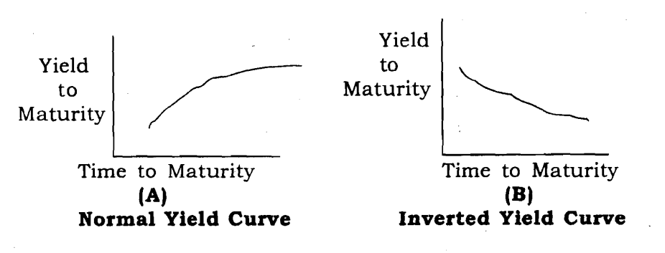
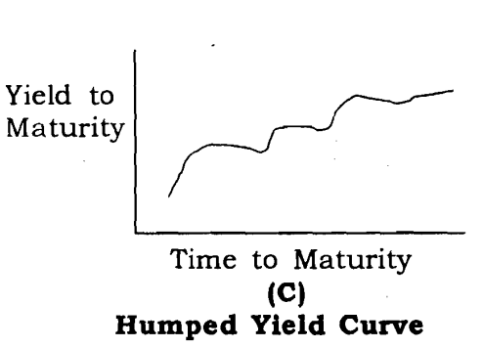
Term Structure Of Interest Rates
Yield Curve

Slide 83
Term Structure Theories

